Slide 1
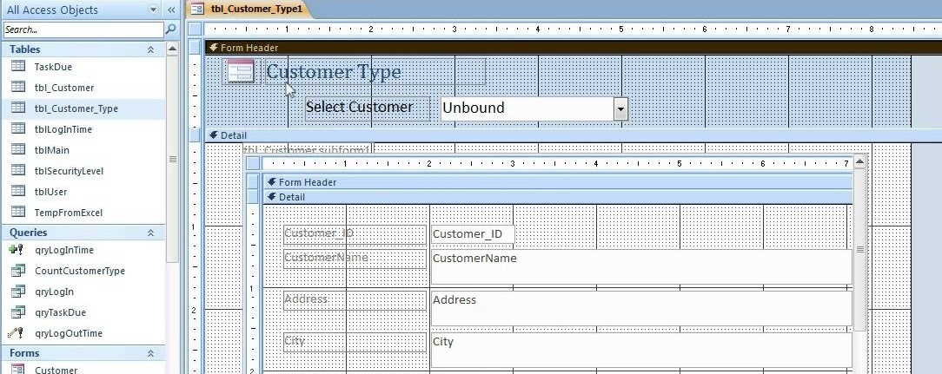
OCR Level 02 – Cambridge Technical
Unit 05 – Creating Business Solutions
2016 Specification - L/615/1355
LO3 - Be able to Present Business Solutions to Stakeholders

Slide 2
Assessment Criteria
The Learner will | Pass The assessment criteria are the pass requirements for this unit. The learner can: | Merit To achieve a merit the evidence must show that, in addition to the pass criteria, the learner is able to: | Distinction To achieve a distinction the evidence must show that, in addition to the pass and merit criteria, the learner is able to:
1. Understand the role of the digital Business Practitioner | P1: Describe how the digital business practitioner supports business.
2. Be able to design solutions to meet business needs | P2: Design a solution to meet the identified business need. |  | D1: Justify how the design proposal supports the business needs.
3. Be able to present business solutions to stakeholders | P3: Create a prototype of the proposed business solution. | M1: Modify the design in response to stakeholder feedback.
 | P4: Present the prototype to identified stakeholders.
4. Be able to use IT applications to meet business needs. | P5: Create the proposed business solution. | M2: Test the solution to confirm functionality. | D2: Assess the appropriateness of the solution to the business need.
 | P6: Gather feedback from stakeholders of the proposed solution.

Slide 3
LO3 – Learning Outcome
Learning Outcome 3: Be able to present business solutions to stakeholders
Your task is to: use the design you created in Task 2 to create a prototype of the solution. You must then present the prototype to a representative from Westwood Recruitment Services (WRS) (this might be your tutor). Finally, you will get feedback about your prototype from the representative from WRS (this might be your tutor) before using this feedback to modify the design you have created.
Pass | Merit | Distinction
P3: Create a prototype of the proposed business solution
P4: Present the prototype to identified stakeholders | M1: Modify the design in response to stakeholder feedback
Evidence
An audio/visual presentation of the prototype and the discussion following the presentation, or a copy of the presentation with detailed speaker notes and notes of the discussions with the stakeholder. This must include: evidence of the prototype of the proposed business solution; the materials presented to the stakeholder; evidence that the prototype has been presented to the stakeholder; feedback from the stakeholder. Amended designs of the prototype (which could include a remodelled prototype). This must include: evidence of what has been changed in the prototype and why the changes have been made.

Slide 4
Assessment Criterion P3, P4, M1
P3 - The learner must create a prototype of the proposed business solution and the evidence would be the actual prototype.
P4 - The learner must present the prototype to the identified stakeholders. The evidence could be an audio/visual presentation of the prototype and the discussion following the presentation, a copy of the presentation with detailed speaker notes and notes of the discussions with the stakeholder.
M1 - The learner must modify the design in response to stakeholder feedback. The evidence should follow on from P4 and P5, and would include the amended designs which could include a remodelled prototype.

Slide 5
LO3 - Assessment Criterion
3.1. Create prototype of the proposed business solution
3.2. Present the design to the stakeholder, e.g.:
select presentation style
present prototype
answer questions
seek clarification
make recommendations
gather feedback from stakeholders.
M1.1. Modify the design in response to stakeholder feedback, i.e.:
highlight changes
create new documentation with version control.
Why do teachers do registers each lesson What happens if my attendance drops below 95%. Who will know? What Management System does my school have Can I see my own grades How much data is automated and how much needs to be typed.

Slide 6
Unit 05 - Scenario
IT applications are commonly found in businesses. Digital practitioners play an important role in supporting businesses. You will design and create a business solution in conjunction with a stakeholder.
Progress Solutions for Business
Progress Solutions for Business is an existing organisation that offers administration services for businesses and organisations, as well as creating business solutions. The staff consists of:
• a manager who has overall control of the organisation and also markets Progress Solutions for Business to external clients;
• a supervisor who oversees the work of the administrative staff;
• six administrative staff who provide the administration services.
It provides the following services:
• word processing of reports and letters;
• production of leaflets and brochures with graphical images;
• creation of presentations which could include graphical images, video and audio clips and animations;
• spreadsheet solutions;
• database solutions;
• website creations;
• social media consultancy;
• business IT applications.
A client, Westwood Recruitment Services (WRS), is an employment agency which specialises in providing staff for the hospitality industry. The agency has vetted the CVs supplied to them by applicants to match these with a potential job role e.g. chef. When an employer has a vacancy for a job such as a chef, WRS will let applicants know about the job role and find out if they wish to be interviewed for the position. WRS will set a closing date, and after the closing date it will arrange interviews for all the applicants interested in the post, sending them a letter inviting them for interview. The letter will inform the applicant about the location, date and time of the interview, as well as any other key details that may be relevant.
Why do teachers do registers each lesson What happens if my attendance drops below 95%. Who will know? What Management System does my school have Can I see my own grades How much data is automated and how much needs to be typed.

Slide 7
P3.1 – Create a Prototype
For P3 you need to make a prototype of the solution. A prototype is a mock example of the finished product, but not the finished product.
Whichever method or solution you have chosen, you will need to go into that program and think clearly about how you will want it laid out.
P3.1 – Task 01 – Design the structure and pages of your solution.
For this you should go into word, or PowerPoint and sketch the layout of your proposed solution to make it clear to the client how you expect the interface and sections to look.
P3.1 – Task 02 - Create prototype of the proposed business solution.
Next you need to make the basic sections of the proposed solution.
For example, in my solution I would create one client in a table called Staff, one client in a table called Employers with employer details, one table called preferred employers which has staff and columns for each preferred employer.
Then create 3 forms for each of these.
Then create or mock up a proposed Input form for the Employer/Employee choice (it does not have to work)
Design a query.
Design a report (it does not need to fully work) with details of the invite to interview.
Take evidence of each of these.

Slide 8
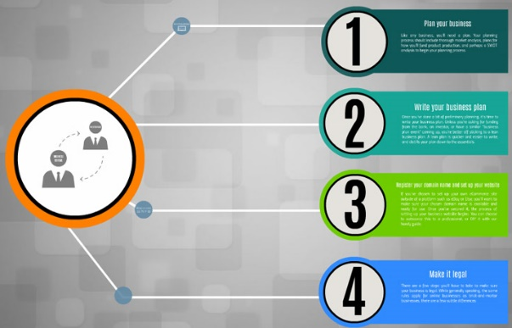
P3.2 – Present Client Designs
For the first part of this task, prepare a questionnaire with 10 questions, 6 with yes/no styled questions (look, ease of use, content e.g. table information), 2 with feedback questions (why) and two with recommendation questions.
P3.2 – Task 03 – Prepare a questionnaire to gather feedback from stakeholders
For P3.2 you will need to take evidence from your prototype, including the sketches and prepare a presentation on these. The presentation should include the following slides:
Client Scenario, expected Outcomes
How you interpret the stages of the scenario
Sketches for the proposed solution.
Evidence of the Prototype (several slides)
How you expect the prototype to achieve the scenario.
Then you need to select presentation style (PowerPoint, Prezie template, Webpage, Word) and present the prototype.

Slide 9
P4.1 – Present Client Designs
P4.1 – Task 04 - Present the design to the stakeholder.
Answer questions from the stakeholder during and after the proposal presentation.
Seek clarification from the stakeholder on their needs at each stage of the presentation and take notes on questions asked and responses to your own questions asked.
Make recommendations yourself during the presentation in answer to the clients questions, record these as part of the task.
P4.2 – Task 05 – Gather feedback on the design from the stakeholder.

Slide 10
M1.1 – Present Client Designs
Once the presentation is complete and all feedback and suggestions noted, you need to create a report that demonstrates that you sought clarification and prompted recommendations from the client.
M1.1 – Task 06 - Create a report that catalogs suggested changes and responses and recommendations from your questionnaires.
Next you will need to modify the prototype in line with the client feedback. Create a second version of your presentation with version number 2 on it,
M1.2 – Task 07 - Modify the design in response to stakeholder feedback.
You will need to add several slides to the second proposal that highlights changes with some written justification on why the changes have been made.
Link this to the feedback, questionnaires or verbal discussions made during the first presentation.

Slide 11
LO3 – Assessment Criteria
P3.1 – Task 01 – Design the structure and pages of your solution.
P3.1 – Task 02 - Create prototype of the proposed business solution.
P3.2 – Task 03 – Prepare a questionnaire to gather feedback from stakeholders
P4.1 – Task 04 - Present the design to the stakeholder.
P4.2 – Task 05 – Gather feedback on the design from the stakeholder.
M1.1 – Task 06 - Create a report that catalogs suggested changes and responses and recommendations from your questionnaires.
M1.2 – Task 07 - Modify the design in response to stakeholder feedback.

